Slide 1
Course Name: Information Security Analysis and Audit
Course Code: CSE3501
Faculty In-Charge : Dr. P.NITHYANANDAM, Professor
It's not that I'm so smart, it's just that I stay with problems longer.
- Albert Einstein
Resource Material Courtesy
NASSCOM Course Ware Security Analyst Handbook SSC/Q0901

Slide 2
Assessment
Component
CAT1
CAT2
DA
TERM End Exam
Total
Weightage
15 Objective Exam
15 Objective Exam
30
40
---------
100

Slide 3
J- Component Assessment
Component
Review1
Review2
Review3
Total
Weightage
20
30
50
------
100

Slide 4
CSE3501 Information Security Analysis and Audit LTPJC 20244
Pre-requisite: Computer Networks
1 | Fundamentals: Information Security and Threats SSC/N 0901 | 5 hours
Introduction to Information Security - Information Assets & Threats - Common Vulnerabilities and Exposures (CVE). Elements of Information Security - Principles and Concepts – Data Security - Types of Controls
2 | Data Leakage and Prevention SSC/N 0901 | 4 hours
Introduction to Data Leakage - Organizational Data Classification, Location and Pathways - ontent Awareness - Content Analysis Techniques - Data Protection - DLP Limitations - The DRM – DLP Conundrum
3 | Information Security Policies, Procedures, Standards and Guidelines SSC/N 0901 | 4 hours
Information Security Policies - Key Elements of Security Policy - Security Standards, Guidelines & Frameworks - Security Standards Organizations - Information Security Laws, Regulations and Guidelines
4 | Information Security Management and Metrics SSC/N 0901 | 4 hours
Information and Data Security Team Structure - Security incident response team. Introduction to Security Metrics - Types of Security Metrics - Using Security Metrics - Developing the Metrics Process - Metrics and Reporting - Designing information security measurement systems

Slide 5
5 | Risk Assessment & Configuration Review SSC/N 0901 | 4 hours
Risk Overview - Risk Identification - Risk Analysis - Risk Treatment - Risk Management Feedback Loops - Risk Monitoring. Configuration Management - Organizational SecCM Policy - Identify SecCM Tools - Implementing secure configurations - Unauthorized Access to Configuration Stores.
6 | Incident Response –Roles, and Responsibilities SSC/N 0902 | 3 hours
Incident Response - Handling Different Types of Information Security Incidents - Preparation for Incident Response and Handling. Incident Response Team - Incident Response Team Dependencies - Incident Response Process
7 | Information Security Audit and Features SSC/N 0904 | 4 hours
Information Systems Audit versus Information Security Audit - Scope of the Audit - Constraints of a security audit - Types of Security Audits - Phases of Information Security Audit - Information Security Audit Methodology - Security Testing Frameworks - Audit Process - Auditing Security Practices - Testing Security Technology - Role of an Auditor - Auditor Activities - Information Security Audit Consultants - Required Skills Sets of an Information Security Auditor
8 | Vulnerability Analysis and Penetration Testing SSC/N 0905 | 2 hours
Vulnerability Assessment - Vulnerability Classification - Types of Vulnerability Assessment - Vulnerability Analysis Tools - Reasons for conducting PenTests - Penetration testing stages

Slide 6
 |  | Total Lecture hours: | 30 hours
Text Book(s)
1. 2. 3. 4. | NASSCOM, “Security Analyst” NASSCOM, 2015. Jennifer Francis, Qi Chen, Donna R. Philbrick, Richard H. Willis, “Security Analyst Independence,” 2004, ISBN: 0943205697,9780943205694 Wil Mara, “Information Security Analyst “Cherry Lake Publishing, 2013 EC-Council, “Penetration Testing: Communication Media Testing (EC-Council Certified Security Analyst (ECSA))”, Course Technology, 2010
Reference Books
1. 2. 3. 4. 5. 6. 7 8. 9. | Charles P. Pfleeger, Security in Computing, 4th Edition, Pearson, 2009. Christopher J. Alberts, Audrey J. Dorofee , Managing Information Security Risks, Addison-Wesley Professional, 2004 Peter Zor, The Art of Computer Virus Research and Defense, Pearson Education Ltd, 2005 Lee Allen, Kevin Cardwell, Advanced Penetration Testing for Highly-Secured Environments - Second Edition, PACKT Publishers, 2016 Chuck Easttom , System Forensics Investigation and Response, Second Edition, Jones & Bartlett Learning, 2014 David Kennedy, Jim O’Gorman, Devon Kearns, and Mati Aharoni, Metasploit The Penetration Tester’s Guide, No Starch Press, 2014 Practical Malware Analysis by Michael Sikorski and Andrew Honig, No Starch Press, 2015 Ref Links: https://www.iso.org/isoiec-27001-information-security.html https://csrc.nist.gov/publications/detail/sp/800-55/rev-1/final https://www.sans.org/reading-room/whitepapers/threats/paper/34180 https://www.sscnasscom.com/qualification-pack/SSC/Q0901/

Slide 7
List of Experiments
Provide inputs to root cause analysis and the resolution of information security issues, where required
Networking equipment (routers & switches)
Access to all security sites like ISO, PIC, DSS etc.
Commercial tools like HP Web Inspect and IBM AppScan etc.
Open source tools like sqlmap, Nessus etc.
Monitor systems and apply controls in line with information security policies, procedures and guidelines
Access to all security sites like ISO, PCI DSS, Center for Internet Security etc.
Security templates from ITIL & ISO

Slide 8
Security assessment of information security systems using automated tools
Exploring and Auditing a Network Using Nmap
Vulnerability Analysis Using the Nessus Tool
Scanning a Local Machine for Open Ports Using TCPView
User Activity Monitoring and Recording Using Power Spy 2013
Capture Remote Interfaces Using Wireshark
Recovering Data Using the Recover My Files Tool
Performing Hash, Checksum, or HMAC Calculations Using the HashCalc Tool
.NET Configuration Management and Secure Code Review
.NET Error Handling, Auditing, and Logging
Securing Forms Authentication Cookies using SSL
Securing Form Authentication Credentials
Creating Separate Folders for Secure Pages in the Application
Validating Passwords on the CreateUserWizard Control Using Regular Expressions
Securing Information with a Strong Symmetric Encryption Algorithm
Anti-Virus and Anti-Spam software
Vulnerability Identification and Prioritization
Web Application Security Configuration
Penetration Testing
MySQL SQL Injection
Risk Assessment
Information security incident management

Slide 9
Objective of the course
Conduct assessments for security threats and vulnerabilities, determine deviations from acceptable pre-defined configurations, enterprise or local policy, assess the level of risk
Develop or recommend appropriate mitigation countermeasures in operational and non-operational Situations
Devise testing standards and cases of confidentiality, integrity, authentication, availability, authorization, and non-repudiation of information
Define and implement privacy standards, build privacy awareness to protect an organization’s information assets

Slide 10
Expected Outcome
After successfully completing the course the student should be able to
Carry out security assessment of information security systems using automated tools
Analyze information security performance metrics to highlight variances and issues
for action by appropriate people
Record, classify and prioritize information security incidents using standard
templates and tools
Organize data/information required for information security audits using standard
templates and tools
Liaise with appropriate people to gather data/information required for
information security audits
Carry out required audit tasks using standard tools and following established procedures/guidelines/checklists
Identify the requirements of information security audits and prepare for
audits in advance

Slide 11
Fundamentals: Information Security and Threats
Information Security Professionals Responsibilities
Entry level - operate the software to monitor and analyze information
Senior level - carry out investigative work to determine whether a security
breach has occurred
Higher level - people design systems and architecture to address these vulnerabilities

Slide 12
Security Analyst Focus
Risk Assessment - risk/issues an organization may faces
Vulnerability Assessment – an organization weakness to threats
Defence planning – designing protection architecture/installing firewall/encryption

Slide 13
Why Information Security?
Role of a Security Analyst in IT
Protect information systems
Perform investigations
Ensuring CIA triad
Risk Assessment
Vulnerability Assessment
Defence Planning

Slide 14
Skills of Security Analyst
Understanding security policy
Data & Traffic Analysis
Identifying Security Events –> How & when to alarm
Incident Response

Slide 15
Foundation and Background
Network infrastructure knowledge
Diverse device configuration ability
Security configuration knowledge
Data management & teamwork

Slide 16
Challenges for Security Analyst
Not tied to a product or solution
Complex knowledge – Not one specific process is correct or product solution
Diverse set of skills are needed

Slide 17
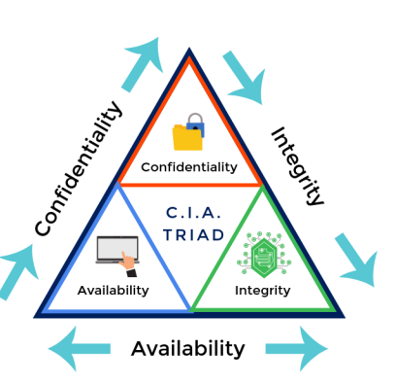
Information Assets and Threats
Confidentiality- Prevention of unauthorized disclosure or use of information assets
Integrity - Prevention of unauthorized modification of information assets
Availability - Ensuring authorized access of information assets when required
for the duration required

Slide 18
Threat to Information Assets
Risk is the potential threat, and process of understanding and responding to factors that may lead to a failure in the confidentiality, integrity or availability of an information system constitute risk
theft
fraud/ forgery
unauthorized information access
interception or modification of data and data management systems

Slide 19
Vulnerabilities - weakness in an information system, system security procedures, internal controls, or implementation that could be exploited or triggered by a threat source
Threat agent - intent/method that may trigger the vulnerability
Threat vector – path/tool that a threat actor uses to attack the target.
Threat targets – PC/ laptop/PDA/tablet/mobile/phone/online bank account

Slide 20
Threat Classification
Spoofing of user identity
Tampering
Repudiation
Information disclosure (privacy breach or data leak)
Denial of Service (D.o.S.)
Elevation of privilege

Slide 21
Threat Agents
Non-Target specific: Non-Target specific threat agents are computer viruses, worms, Trojans and logic bombs.
Employees: staff, contractors, operational/ maintenance personnel or security guards who are annoyed with the company.
Organized crime and criminals: criminals target information that is of value to them, such as bank accounts, credit cards or intellectual property that can be converted into money.
Criminals will often make use of insiders to help them.
Corporations: corporations are engaged in offensive information warfare or competitive intelligence. Partners and competitors come under this category.
Unintentional human error: accidents, carelessness etc.
Intentional human error: insider, outsider etc.
Natural: Flood, fire, lightning, meteor, earthquakes etc

Slide 22
Types of Attacks
Virus
Worms
Trojans

Slide 23
Type of Viruses
Resident virus
Non-resident virus
Boot sector virus
Macro virus
File-infecting virus - prepending beginning / middle /end/ cavity virus
Polymorphic virus - that uses a polymorphic engine to mutate while keeping the
original algorithm intact
Metamorphic virus - capable of changing its own code with each infection
Stealth virus
Armored virus
Multipartite virus
Camouflage virus
Companion virus
Cavity virus

Slide 24
Types of Worms
Email worms: spread through email messages, especially through those with attachments.
Internet worms: spread directly over the internet by exploiting access to open ports or system
vulnerabilities.
Network worms: spread over open and unprotected network shares.
Multi-vector worms: having two or more various spread capabilities.

Slide 25
Types of Trojans
Trojans do not self-replicate since its key difference to a virus and require often end user intervention to install itself
Backdoor Trojan
DDoS Trojan
Proxy Trojan
FTP Trojan
Destructive Trojan
Security Software Disable Trojan
Info Stealer Trojan
Keylogger Trojan
Password Trojan
Banker Trojan
Instant Messenger Trojan

Slide 26
Types of Trojans continued….
Game Thief Trojan
Mail Finder Trojan
Dropper Trojan
Downloader Trojan
FakeAV Trojan
Spy Trojan
ArcBomb Trojan
Clicker Trojan
SMS Trojan
Ransom Trojan
Crypt lock Trojan

Slide 27
Other Security Threats
Rootkit
Spyware
Tracking Cookies
Riskware
Adware
Scareware
Creepware
Blended threat - Usage of multiple attack vectors and payload types targets
to increase the severity of the damage

Slide 28
Network Attacks
Passive Attack - the purpose is only to learn and get some information from the system, but the system resources are not altered or disabled in any way
Active attacks: - In this type of network attack, the perpetrator accesses and either alters disables or destroys resources or data
Outside attacks
Insider attacks
Targeted attacks – (like phishing or social engineering)

Slide 29
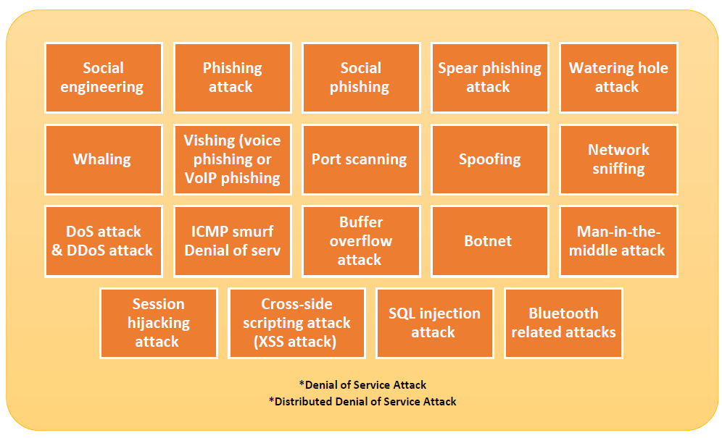
Security Attacks

Slide 30
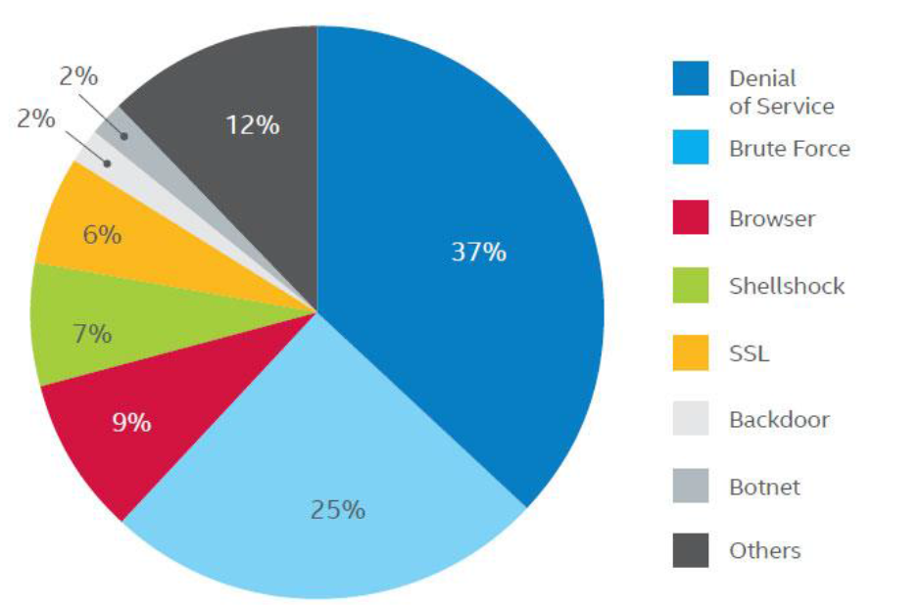
Top Network Attacks

Slide 31
Common Vulnerabilities and Exposure (CVF)
Vulnerabilities - is a mistake in software code that provides an attacker
with direct access to a system or network
Exposure - is a mistake in software code that provides an attacker
with in- direct access to a system or network

Slide 32
Fundamentals of Information Security
Elements of Information Security
Network Security
Application Security
Communication Security

Slide 33
Network Security
Any activity designed to protect our network
No single solution protect from a variety of threats; need multiple layer of security
It is attained via both h/w and s/w
Network security components include
    Anti-virus and anti-spyware
    Firewall to block unauthorized access
    IPS to detect to zero day/hour attack
    VPN to provide secure remote access
    Communication Security

Slide 34
Application Security
It is a practice of use of software/hardware/procedural methods to protect application from external threats
It helps to identify, fix and prevent security vulnerabilities in any kind of software application irrespective of the function, language or platform.
A software vulnerability can be defined as a programmatic function that processes critical data in an insecure way
These “holes” in an application can be exploited by a hacker/spy/cybercriminal
as an entry point to steal sensitive, protected or confidential data.

Slide 35
Source of application development are as follows:
in-house development teams,
commercial vendors,
outsourced solution providers, and
open source projects
Software developers have an endless choice of programming languages to choose from – Java, .NET, C++, PHP and more.
Applications can be deployed across myriad platforms – installed to operate locally, over virtual servers and networks, accessed as a service in the cloud or run on mobile devices.

Slide 36
Assessing potential vulnerabilities on Softwares
Follow remediation procedures to prioritize and fix them.
Train developers on secure coding practices
Leverage ongoing threat intelligence to keep up-to-date
Develop continuous methods to secure applications throughout the development life cycle
Instantiate policies and procedures that instill good governance

Slide 37
Communication Security
Communications Security (COMSEC) ensures the security of telecommunications confidentiality and integrity – the two information assurance (IA) pillars
Cryptosecurity: This encrypts data, rendering it unreadable until the data is decrypted.
Emission Security (EMSEC): This prevents the release or capture of emanations from equipment, such as cryptographic equipment, thereby preventing unauthorized interception.
Physical Security: This ensures the safety of, and prevents unauthorized access to, cryptographic information, documents and equipment.
Traffic-Flow Security: This hides messages and message characteristics flowing on a network.
Transmission Security (TRANSEC): This protects transmissions from unauthorized access, thereby preventing interruption and harm

Slide 38
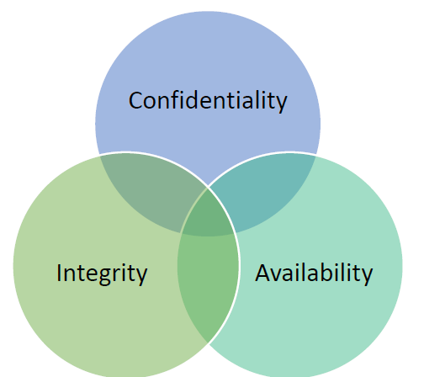
Principles and Concepts- Data Security
Information characteristics

Slide 39
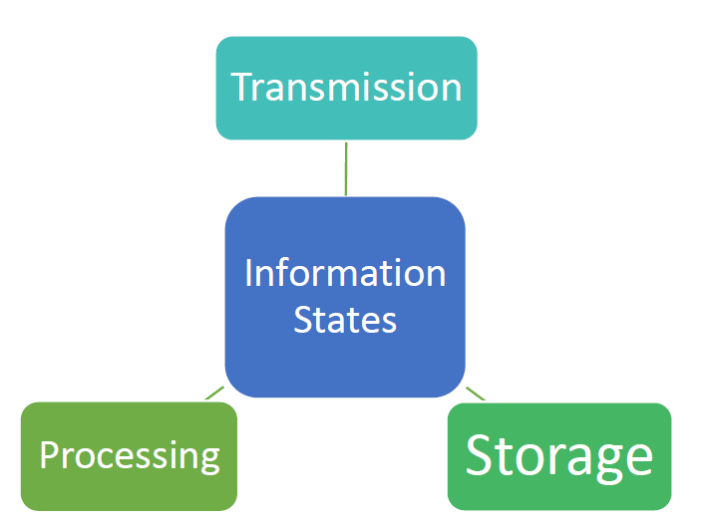
Information states

Slide 40
Basic Information Security Concepts
Identification
Authentication
Authorization
Confidentiality
Integrity
Availability
Non-repudiation

Slide 41
Non-Repudiation – ISO 14516:2002 Guidelines
Approval: non-repudiation of approval provides proof of who is responsible for
approval of the contents of a message.
Sending: non-repudiation of sending provides proof of who sent the message.
Origin: non-repudiation of origin is a combination of approval and sending.
Submission: non-repudiation of submission provides proof that a delivery agent has
accepted the message for transmission.
Transport: non-repudiation of transport provides proof for the message originator
that a delivery agent has delivered the message to the intended recipient.
Receipt: non-repudiation of receipt provides proof that the recipient received the
message.
Knowledge: non-repudiation of knowledge provides proof that the recipient
recognized the content of the received message.
Delivery: non-repudiation of delivery is a combination of receipt and knowledge,
as it provides proof that the recipient received and recognized
the content of the message.
Notes:
1

Slide 42
Types of Controls
Central to information security is the concept of controls, which may be categorized by their
Functionality
      preventive
      detective
      corrective
      deterrent
      recovery
      compensating
Plane of application
      physical – doors/security/fire extinguishers/flood protection
      Administrative – organization policies and procedures
      technical – Firewalls/IDS/IPS/File encryption

Slide 43
Access Control Models
Access control models define how computers enforce access of subjects (such as users, other computers, applications and so on) to objects (such as computers, files, directories, applications, servers and devices).
The access control model are as follows:
Discretionary Access Control model
Mandatory Access Control model
Role Based Access Control model
For additional learning refer : https://www.youtube.com/watch?v=ESz4ts7g_zw

